Slide 1
أكـــــاديميــــة طــــويـــق
Artificial Intelligence Ethics

Slide 2
Model Transparency and Ethics in Law
By: Dr. Afshan Hashmi

Slide 3
Course Objectives:
Understand the concept of model transparency and why it is important. Identify different types of interpretable (transparent) models. Recognize the trade-offs between model interpretability and performance. Understand the importance of transparency in AI from an ethical and legal perspective. Identify key legal frameworks governing AI transparency, including GDPR and AI-specific regulations. Discuss the ethical responsibilities of AI developers in ensuring model interpretability. Evaluate real-world case studies where transparency (or lack of it) had ethical and legal consequences.

Slide 4

Model Transparency
What is Model Transparency?
Model transparency refers to how easily a human can understand the inner workings of a machine learning model. A transparent model allows users to see how input features influence predictions in a clear and intuitive way.
Why is Model Transparency Important?
In many real-world applications, machine learning models make decisions that significantly impact people’s lives. Consider these examples:
Healthcare: A model predicting disease risk must be interpretable so that doctors can trust and explain its predictions.
Finance: Loan approval systems must be transparent to ensure fairness and avoid discrimination.
Legal Compliance: Regulations like GDPR require that AI decisions be explainable, especially in high-risk scenarios.
Thus, ensuring transparency helps with trust, fairness, debugging, and regulatory compliance.

Slide 5
Transparent Models
Some machine learning models are naturally interpretable. These models provide direct insight into how they make predictions and why certain features are important.
A. Decision Trees: A Step-by-Step Breakdown
Decision Trees are one of the most interpretable machine learning models. They work by splitting data based on feature values in a stepwise fashion, forming a tree-like structure.
Advantages:
Easy to visualize and explain.
Captures non-linear relationships.
Limitations:
❌ Can become too complex (deep trees). ❌ Prone to overfitting without pruning.

Slide 6
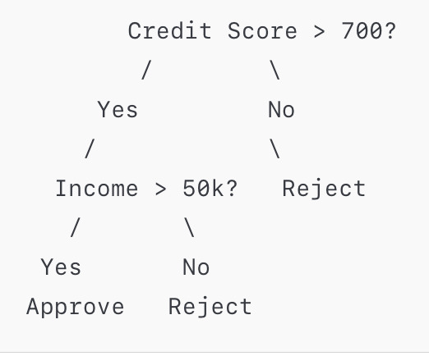
Example: A Simple Decision Tree for Loan Approval
Consider a bank deciding whether to approve a loan based on income and credit score.
This tree is easy to understand:
If a person has a credit score > 700 and income > 50k, they get a loan.
Otherwise, they are rejected.

Slide 7
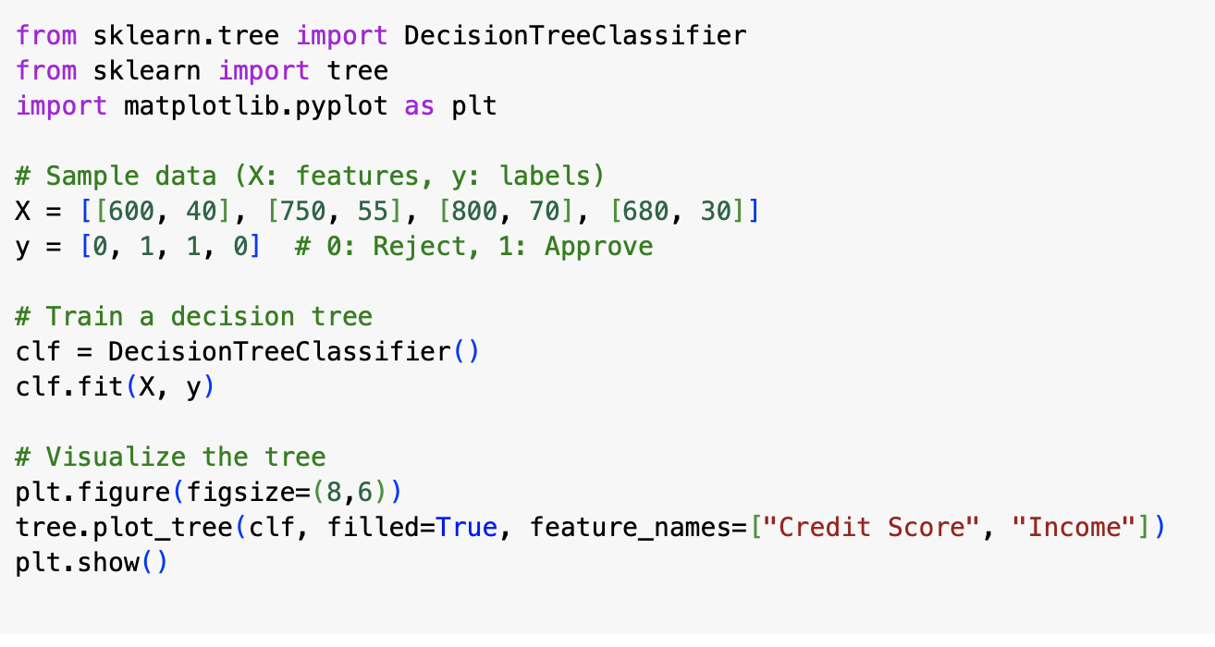
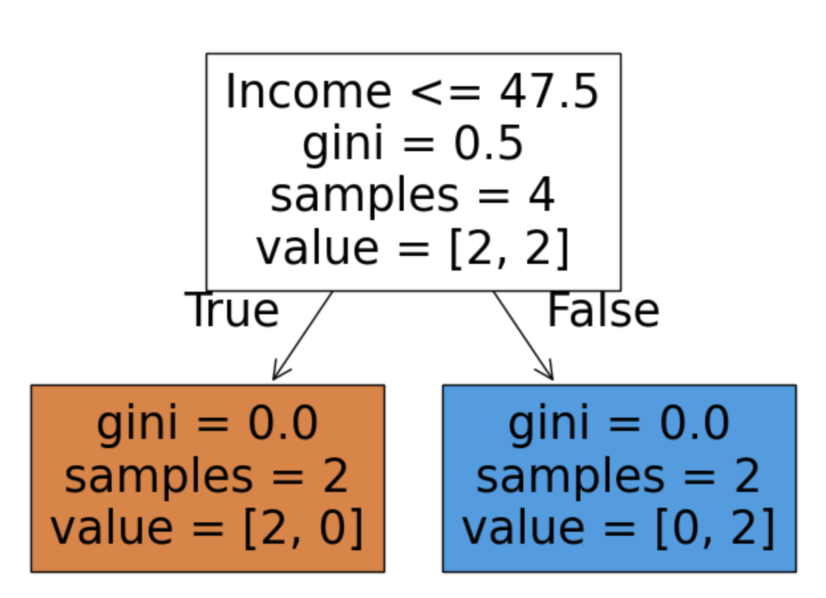
Python Implementation: A Simple Decision Tree for Loan Approval
Consider a bank deciding whether to approve a loan based on income and credit score.

Slide 8
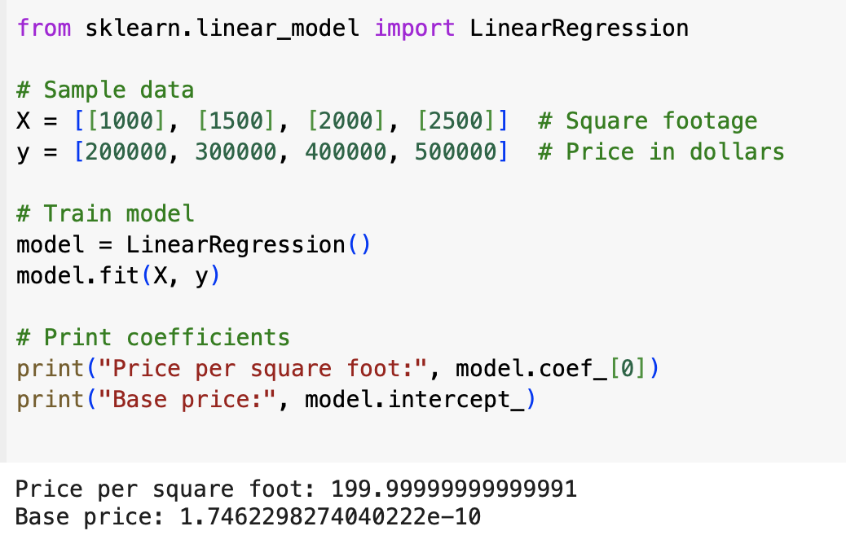
Linear Regression: A Transparent Model for Continuous Data
Linear Regression is one of the simplest and most interpretable models for predicting a continuous output.
Example: Predicting House Prices Suppose we want to predict the price of a house based on its square footage.
Formula:
Price=β0​+β1​×Square Footage
where:
β0 is the intercept (base price).
β1 is the coefficient (price per square foot).
Interpretation:
1. If the coefficient is 200, it means each additional square foot increases the house price by $200.
2. The model is fully transparent since each input directly affects the prediction.

Slide 9
Trade-offs Between Transparency and Performance
While transparent models are interpretable, they may not always perform well in complex tasks.
Feature | Transparent Models (Decision Trees, Linear Regression) | Black-Box Models (Neural Networks, Ensembles)
Interpretability | High (easy to understand) | Low (hard to explain)
Accuracy | Moderate | High
Complexity | Low | High
Computational Cost | Low | High
When to Use Transparent Models?
When interpretability is a priority (e.g., healthcare, finance).
When debugging and explaining predictions is necessary.
When to Use Black-Box Models?
When high accuracy is needed (e.g., image recognition, NLP).
When relationships between features are highly complex.

Slide 10
Introduction to AI Transparency in Ethics and Law
What is AI Transparency?
AI transparency refers to the ability to explain how and why an AI system makes decisions. This includes:
Understanding how data is processed
Knowing which features impact decisions
Ensuring stakeholders can interpret and trust the model
Transparency is essential because AI systems increasingly affect human lives in critical areas such as finance, healthcare, criminal justice, and employment.
Why is AI Transparency Important?
Trust and Accountability – Users and stakeholders must trust AI decisions. Fairness and Bias Prevention – Lack of transparency can lead to discriminatory outcomes. Legal Compliance – Regulations require AI to be explainable in high-stakes areas. Security and Safety – Transparency helps detect unintended behavior in AI models.

Slide 11
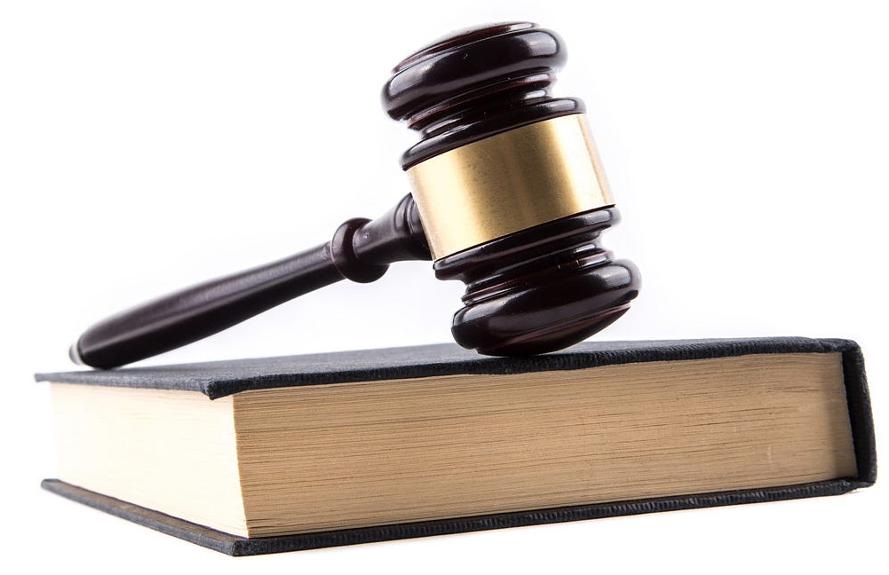
Legal Requirements for Transparency in AI
A. General Data Protection Regulation (GDPR)
The GDPR (enforced in the European Union) is one of the most influential laws regulating AI transparency. It has specific rules that AI systems must follow:
Right to Explanation (Article 22)
Individuals have the right to receive an explanation of AI-based decisions, especially in automated decision-making (e.g., loan approvals, hiring).
Data Protection (Article 5)
AI must process personal data in a fair, transparent, and accountable manner.
Consent and Data Rights
Users must be informed about how their data is used, and they can request access, corrections, or deletion of their personal information.
Example of GDPR Violation In 2021, Clearview AI, a facial recognition company, was fined by GDPR regulators for illegally collecting personal images from the internet without consent. This highlighted the importance of data transparency and consent.

Slide 12
AI Act (European Union)
The AI Act (expected to be one of the most significant AI laws) classifies AI systems into four risk categories:
Risk Level | Examples | Regulation Requirements
Unacceptable | Social scoring, mass surveillance | Banned
High-Risk | Hiring algorithms, credit scoring, medical AI | Strict transparency & explainability rules
Limited Risk | Chatbots, recommendation systems | Users must be informed
Minimal Risk | AI-generated music, video games | Few regulations
Example: High-Risk AI An AI used in hiring decisions must explain why a candidate was rejected to avoid unfair bias.

Slide 13
Other Global AI Regulations
Country/Region | Key AI Transparency Regulation
🇺🇸 USA | Proposed Algorithmic Accountability Act (requires transparency in automated decision-making)
🇨🇦 Canada | AI and Data Act (AIDA) (focuses on ethical AI use and transparency)
🇬🇧 UK | AI Regulation White Paper (proposes sector-specific transparency guidelines)
🇸🇦 Saudi Arabia | National Strategy for Data & AI (emphasizes responsible AI development)

Slide 14
Ethical Responsibility in AI Transparency
A. The Ethical Principles of AI Transparency
AI ethics is based on five key principles that guide responsible AI development:
Principle | Description | Example
Fairness | AI should not discriminate based on race, gender, or other protected attributes. | AI hiring tools must ensure fairness for all applicants.
Accountability | Developers must be responsible for AI decisions and potential harm. | Self-driving car manufacturers must explain crash decisions.
Explainability | AI decisions should be interpretable by humans. | Doctors must understand why an AI recommends a treatment.
Privacy | AI should protect personal data and user rights. | Chatbots should not store personal conversations without consent.
Safety | AI must be tested to prevent harm or unintended consequences. | AI in autonomous weapons must be strictly controlled.

Slide 15
B. Ensuring User Understanding of AI Models
For AI to be truly transparent, users must understand how it works. Developers must:
Provide clear explanations – Avoid complex AI jargon and simplify outputs.
Use visualizations – Tools like SHAP, LIME, and ELI5 help explain model decisions.
Educate stakeholders – Training sessions for employees using AI systems.
Allow feedback – AI should adapt based on user concerns and errors.
Example: Transparent AI in Healthcare IBM’s AI model for diagnosing diabetes risk uses SHAP values to show doctors which factors influenced the prediction (e.g., blood sugar, weight). This builds trust and user understanding in AI-powered medical tools.

Slide 16
Case Studies: Ethics and Legal Transparency in AI
Case Study 1: Google’s AI Ethics Controversy
What happened?
In 2020, Google fired two AI ethics researchers (Timnit Gebru & Margaret Mitchell) after they published a paper on bias in AI models.
Ethical Issues
Lack of transparency in Google's AI research decisions.
Ethical concerns about bias in large AI models (e.g., GPT-3).
Impact
Sparked a global conversation on AI ethics and corporate responsibility.
Many tech companies now have AI ethics committees to ensure transparency.

Slide 17

Case Study 2: Facebook’s Algorithm and Misinformation
What happened?
Facebook’s AI prioritized engagement over truth, leading to the spread of misinformation during elections.
Legal and Ethical Issues
Lack of transparency about how the algorithm promoted fake news.
Ethical failure in prioritizing profits over public safety.
Impact
Increased regulation of AI-powered social media algorithms.
Push for explainable AI models in content moderation.

Slide 18
Summary
Transparent models (decision trees, linear regression) are easy to understand but may lack performance.
Black-box models (neural networks, ensembles) perform well but require interpretation tools.
SHAP, LIME, and ELI5 help explain complex models. AI transparency is both an ethical and legal necessity for fairness, accountability, and trust.
Regulations like GDPR and AI Act ensure AI models are explainable and protect user rights.
Developers must focus on fairness, explainability, and user education to make AI ethical.
Real-world failures (COMPAS bias, Facebook misinformation) highlight the risks of non-transparent AI.

Slide 19
Practice with Google COLAB
Click here
https://colab.research.google.com/drive/1wPguJV1vy_D496JXyEVLOzZCW49OiDhM

Slide 20

















الشراكات العالمية

Slide 21
شــــــكــــرًا لكــــــم
THANK YOU

